Slide 1

DeepTrim: An automated platform-aware domain-customized framework for Deep Learning
Farinaz Koushanfar
Professor and Henry booker scholar faculty at UCSD
Progress Report
May, 10, 2018

Slide 2
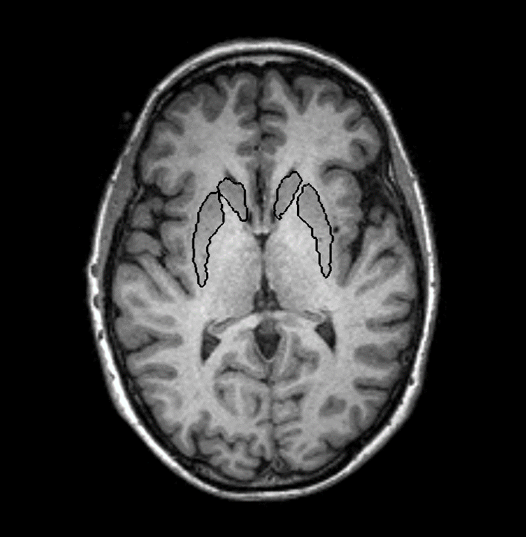
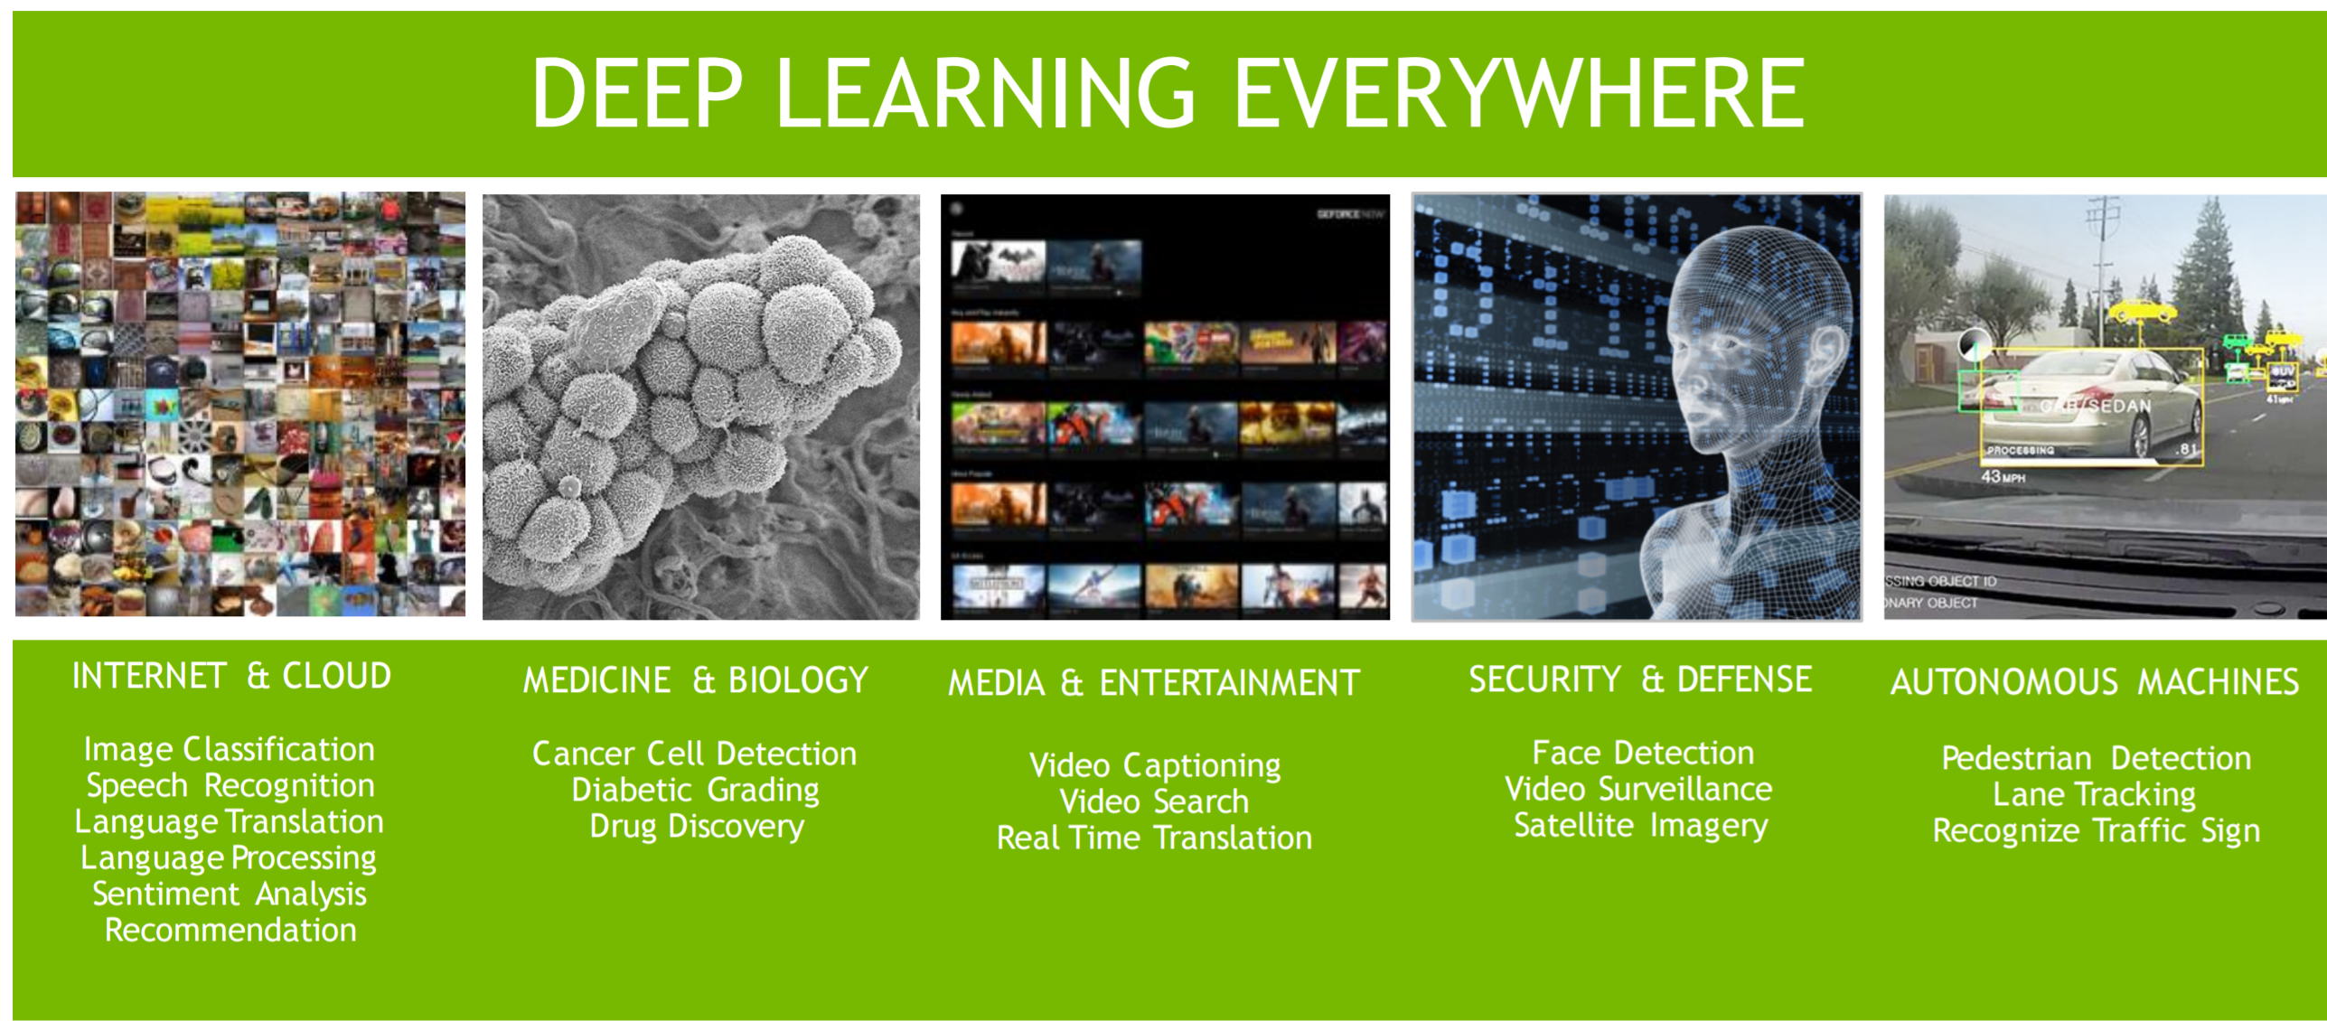
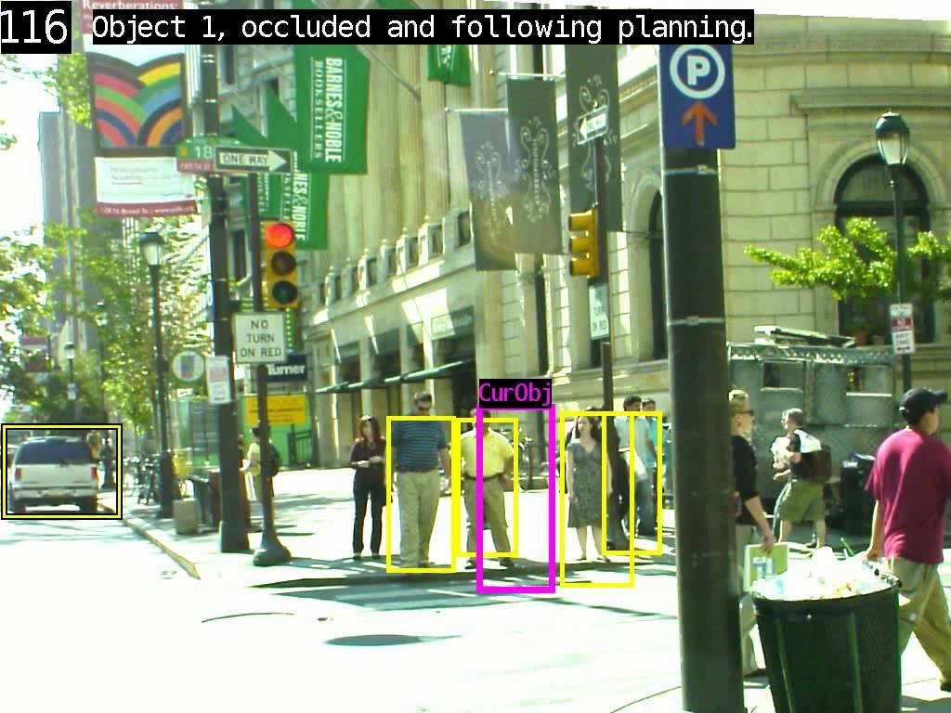
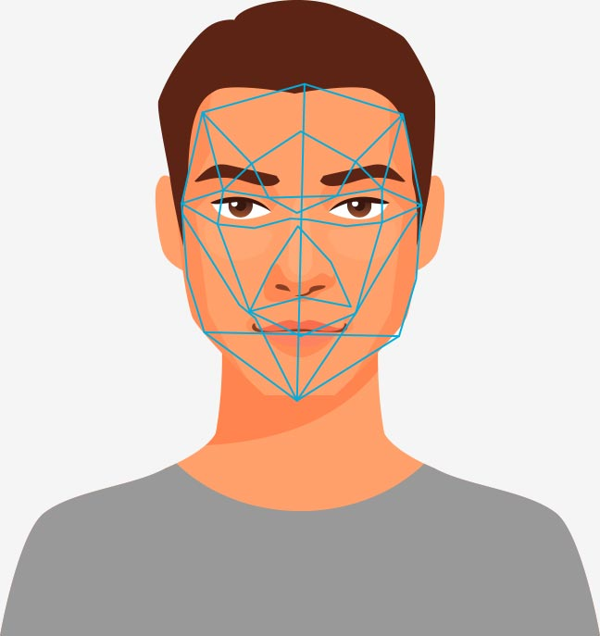
Neural Networks and Vision Applications
Superior inference than traditional machine learning
Medical
Image analysis
Autonomous
Vehicles
Face
Recognition
Object Tracking
Notes:
Deep Learning methodologies are becoming popular
Have achieved superior inference for several field
beyond traditional linear or polynomial analytical machine learning

Slide 3
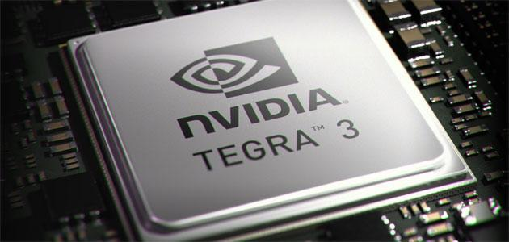
Problem Statement
Deep Learning in resource-constrained settings
Memory/Power/Compute resources
The challenge is to adapt algorithm and data to maximally utilize the limited resources
Notes:
Deep Learning has shown great accuracy for a host of applications
Efficiency matters in most real-world applications. Examples include:
Autonomous cars
Robotics
Voice recognition on cellphones
Neural Networks are computationally intensive
Devices often have limited resources
Memory
Processing elements
Power budget
The challenge is to adapt algorithm and data to maximally utilize the limited resources
High computational overhead limits DL’s performance in resource-constrained settings

Slide 4
State-of-the-art

Slide 5
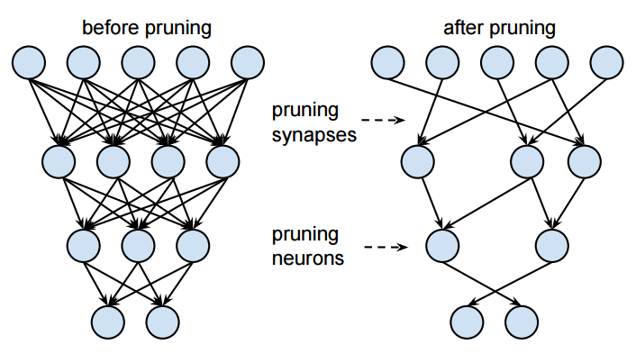
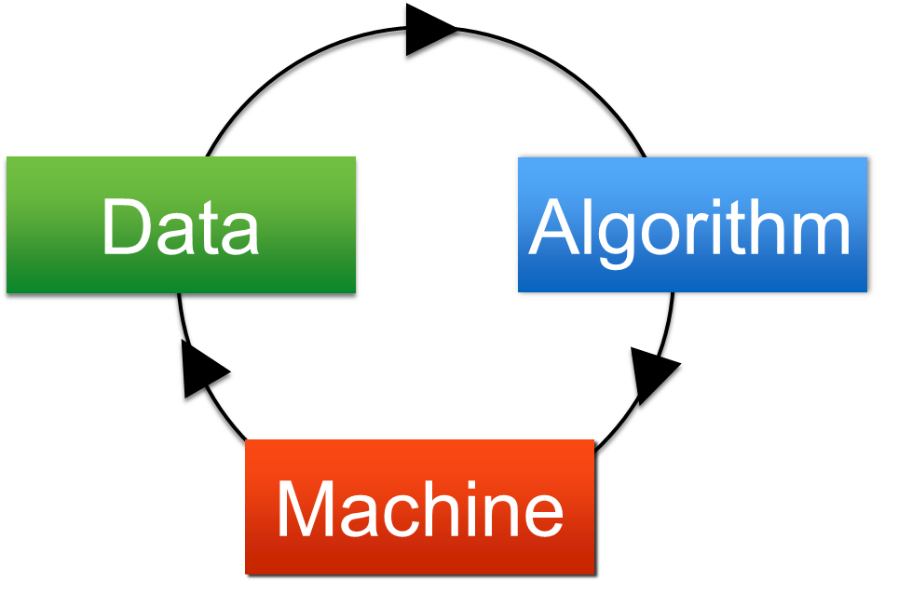
Algorithmic Solutions by Data Scientists
Data scientists optimize algorithms
Example: Network Pruning^{[1]}
Data
Algorithm
[1] Han, Song, et al. "Learning both weights and connections for efficient neural network." in NIPS, 2015.

Slide 6
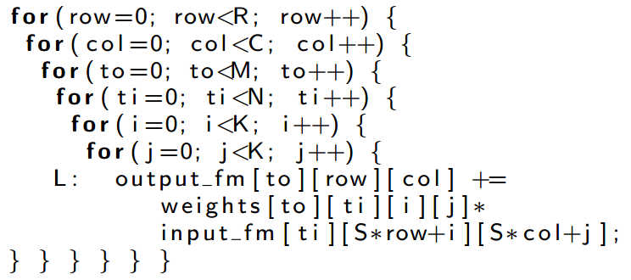
Implementation Solutions by Engineers
Hardware designers and software developers optimize performance
Example: Optimization for FPGA platforms^{[1]} Operation are parallelized, memory bandwidth is optimally utilized, etc.
Data
Algorithm
Hardware
[1] Zhang, Chen, et al. "Optimizing fpga-based accelerator design for deep convolutional neural networks." in FPGA, 2015.

Slide 7
Proposal Summary

Slide 8
Methodology
The classic approach for optimization separates model optimization from hardware optimization
End-to-end solutions will benefit the optimization process of neural network accelerators^{[1][2][3]}
Data
Algorithm
Data
Algorithm
Hardware
Hardware
[1] Rouhani, et al., “Deep3: Leveraging three levels of parallelism for efficient deep learning,” in DAC, 2017
[2] Samragh, et al. “Looknn: Neural network with no multiplication,” in DATE, 2017
[3] Rouhani, et al. "Delight: Adding energy dimension to deep neural networks." in ISLPED, 2016.
[4] Samragh, et al. "Customizing neural networks for efficient fpga implementation." in FCCM, 2017

Slide 9
Methodology
Benefits:
Algorithm is modified based on hardware specifications
The constrained resources of embedded devices can be maximally utilized
Challenges:
How can we abstract hardware specifications?
How can we automate the customization process?
Data
Algorithm
Hardware

Slide 10
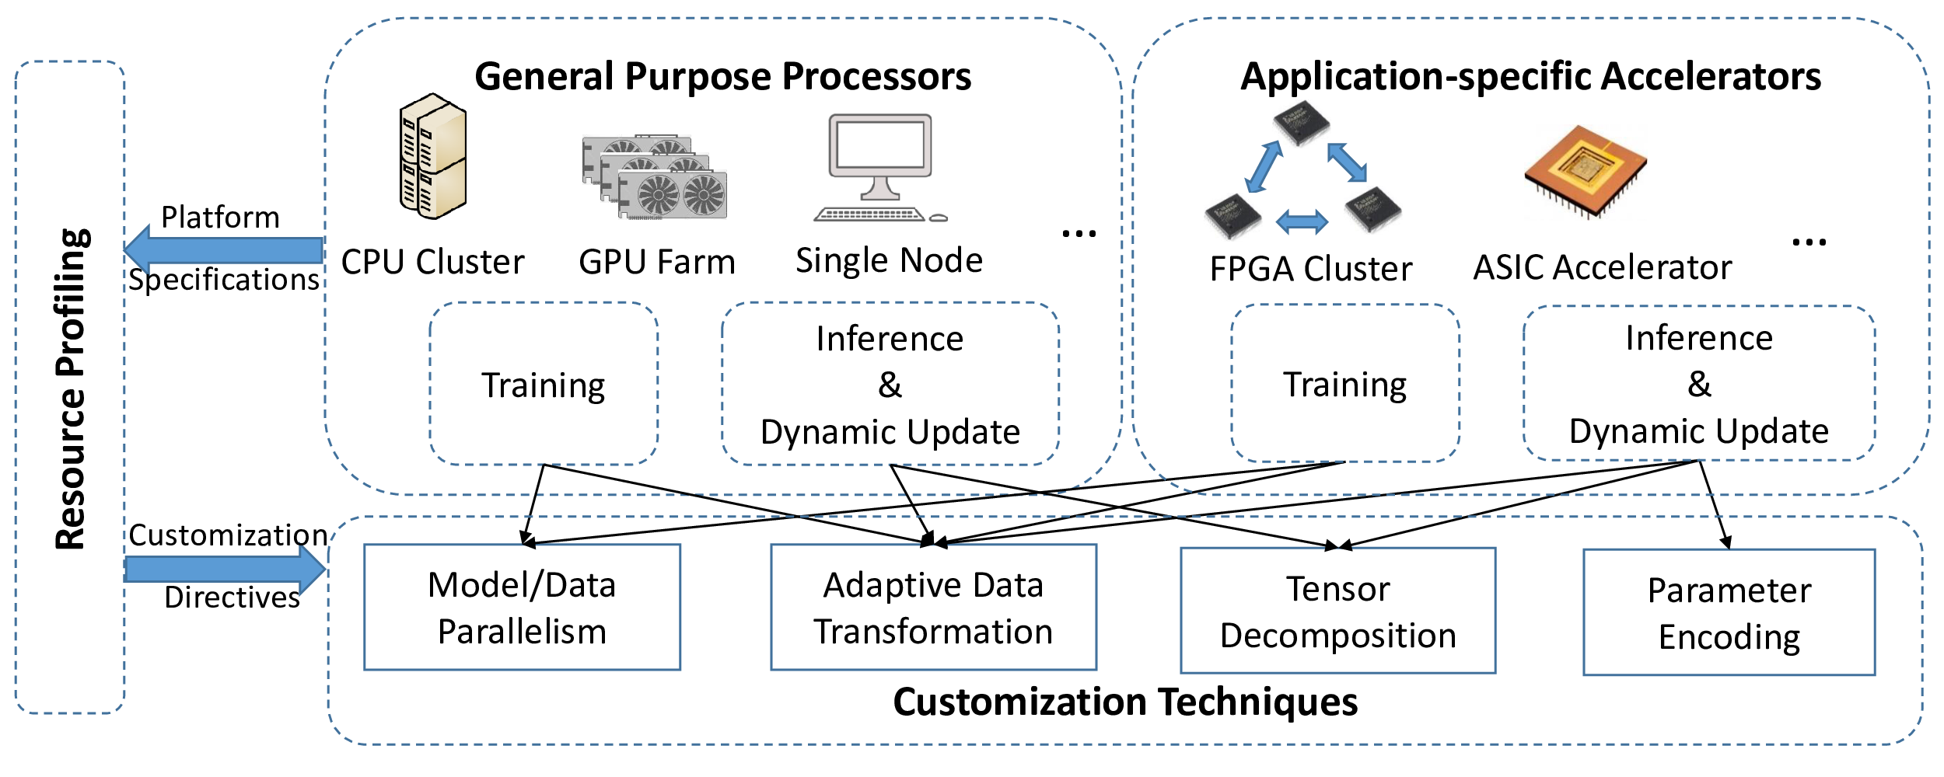
DeepTrim Framework

Slide 11
Resource profiling

Slide 12
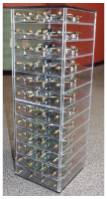




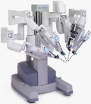
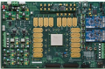

High-level Hardware Characterization
Computing (FLOPs)
Communication Bandwidth (Bytes/sec)
Memory (Bytes)
Cores
I/O
Memory

Slide 13
Customization Techniques

Slide 14
Model/Data Parallelism
1
Load balancing
Data distributed among multiple computing cores
Minimize communication among computing nodes
Depth-first model traversal
A
A
+
A

Slide 15
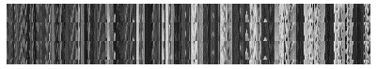

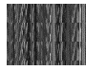

Adaptive Data Transformation
2
A: Raw Data
D: Dictionary (Projection Basis)
C: Coefficient in New Basis

Slide 16
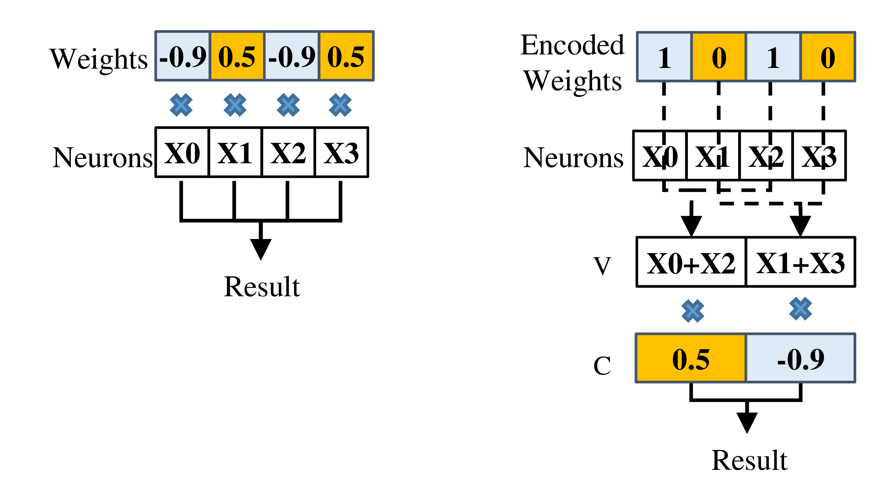
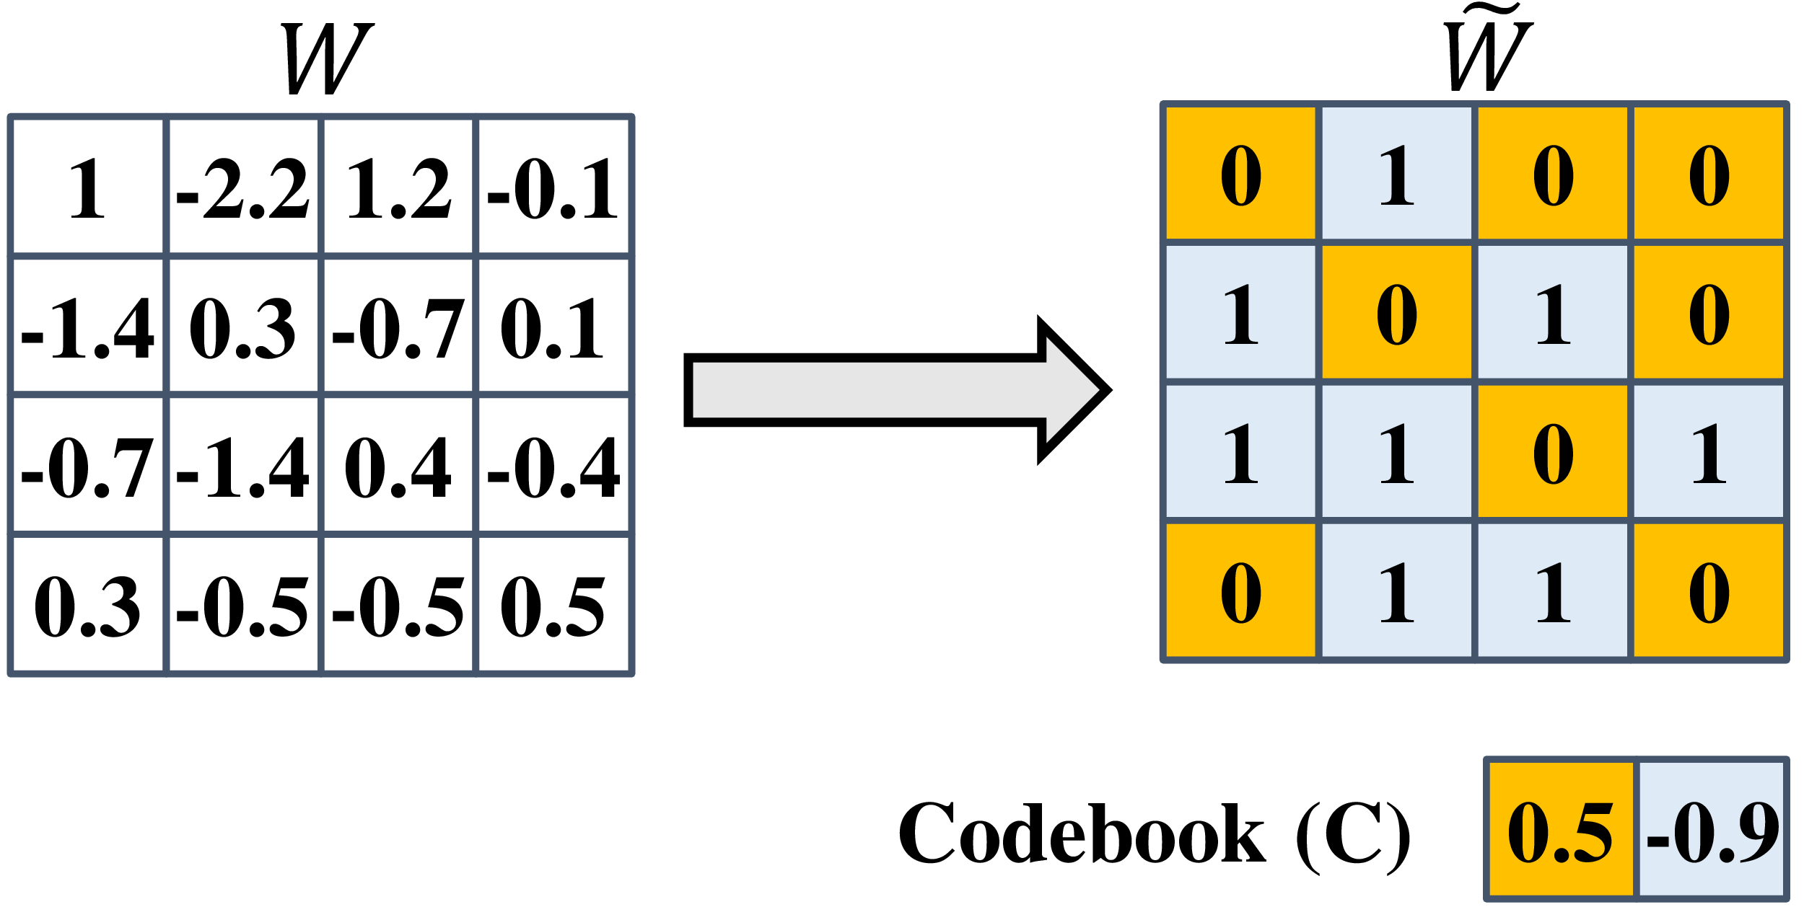
Parameter Encoding
3
Model parameters can be encoded
Benefits:
Compression: low-bit representation
Computation: factorized multiplications

Slide 17
Tensor Decomposition
4
Decompose static element to improve inference efficiency
Kernel tensors for convolutional layers: Tucker vs. CP
Weight matrices for dense layers: SVD
Notes:
Trained model are significantly redundant
Once the model is trained, redundancy can be removed to improve inference efficiency
Computation and storage costs of CNN are dominated by conv and dense layers, respectively
Decompose conv kernels and fully-connected weight matrices to optimize computation and storage

Slide 18
Singular Value Decomposition (SVD)
4
U and V are orthogonal matrices
Σ is diagonal matrix with nonnegative entries, and with the diagonal entries sorted from high to low
Notes:
- The diagonal values in Σ correspond to each left/right singular value for U and V
- Reduce each of those matrices correspondingly to r (rank)
- preserves the r most important linear combinations of sets of vectors

Slide 19
Comparison of Tensor Decomposition Methods
4
CP Decomposition | Tucker Decomposition
Slightly Better decomposition result^{[1]} | Good decomposition result^{[2]}
In-stable when more than 1 layer is decomposed together^{[1, 2]} | No instability issue^{[2]}
VBMF rank selection is inaccurate^{[2]} | VBMF facilitates rank selection^{[2]}
[1] Astrid, Marcella, et al. “Rank Selection of CP-decomposed Convolutional Layers with Variational Bayesian Matrix Factorization,” 2018
[2] Kim, Yong-Deok, et al. “Compression of Deep Convolutional Neural Networks for Fast and Low Power Mobile Applications,” 2016
Notes:
- The diagonal values in Σ correspond to each left/right singular value for U and V
- Reduce each of those matrices correspondingly to r (rank)
- preserves the r most important linear combinations of sets of vectors

Slide 20
Tucker Decomposition
4
Two-way tucker decomposition
Decompose on input dimension and output dimension
Keep kernel dimensions since kernels are usually 3x3 or 5x5
[1] Kim, Yong-Deok, et al. “Compression of Deep Convolutional Neural Networks for Fast and Low Power Mobile Applications,” 2016
Notes:
Visualize kernel dimension (special dimension) 3x3 as the front dimension
Top and side each correspond to input and output dimension
Tucker 2 decomposition decomposes only B and C and keeping A and G intact
Use rank to reduce the dimensions of B C and G similar to SVD

Slide 21
Variational Bayesian Matrix Factorization (VBMF)
4
Employed recently developed global analytic solutions for variational Bayesian matrix factorization^{[1]}
Automatically find noise variance, rank and even provide theoretical condition for perfect rank recovery
We determined the rank by applying global analytic VBMF on mode-3 matricization and mode-4 matricization of kernel tensor K
[1] Nakajima, Nishiki, et al. “Global Analytic Solution of Fully-observed Variational Bayesian Matrix Factorization,” 2016
Notes:
Notice SVD, Tucker all depends heavily on the selection of rank
How to know the best rank?

Slide 22
Target Applications

Slide 23
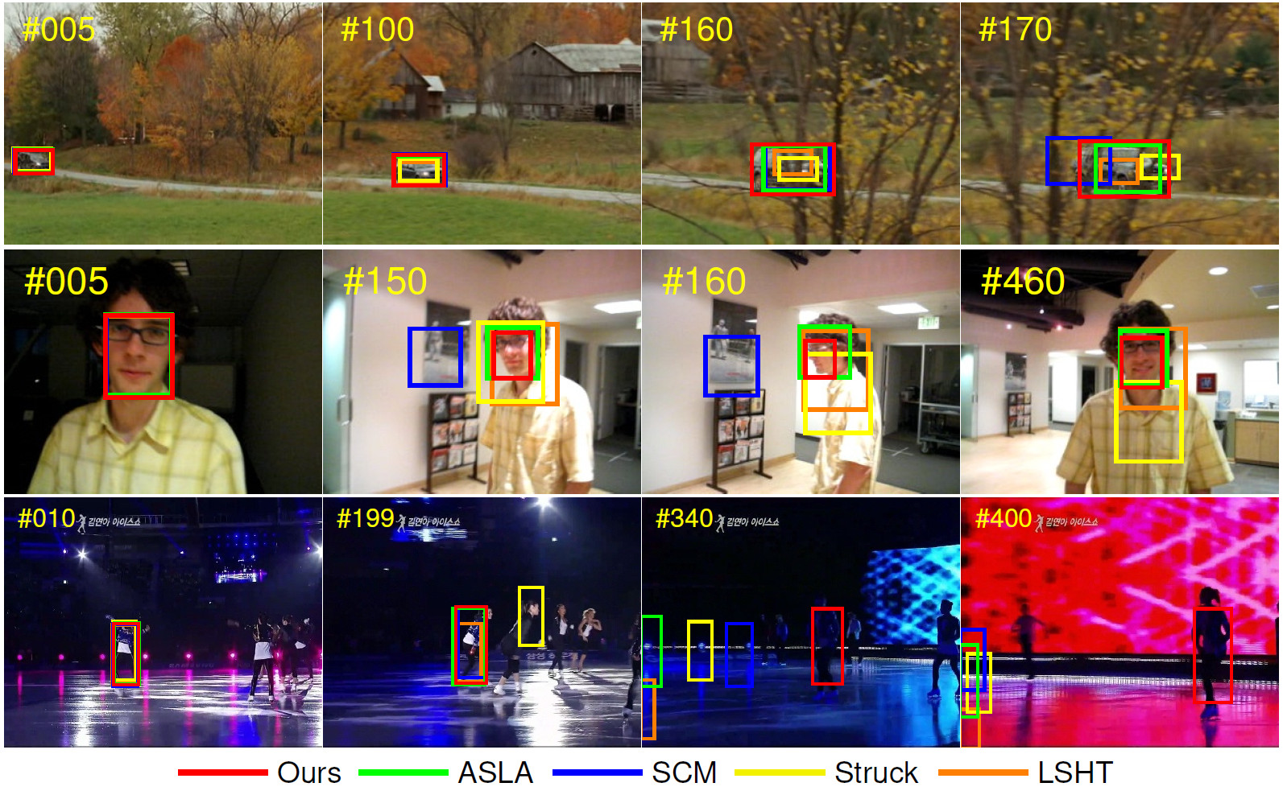
Object Tracking
Given the bounding box for the first frame in a sequence
Identify the bounding box for the each consecutive image in the sequence
Notes:
Performance is measured by the average overlapping between the ground truth bounding box and the generated bounding box

Slide 24
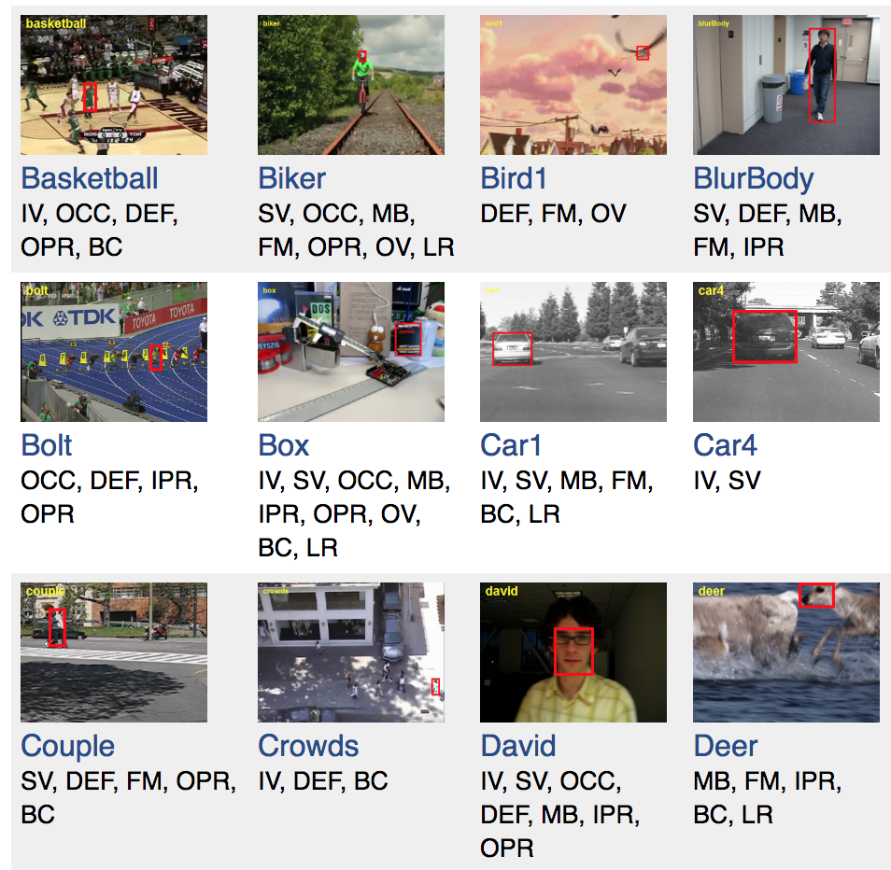
Object Tracking: Benchmarks
Online Object Tracking: A Benchmark^{[1]}
OTB 50
OTB 100
Visual Object Tracking Challenge^{[2]}
VOT 2013
VOT 2014
VOT 2018
[1] Wu, Yi, et al. “Online Object Tracking: A Benchmark,” 2013
[2] Kristan, Matej, at al. “A Novel Performance Evaluation Methodology for Single-Target Trackers,” 2016
Notes:
OTB is a popular tracking benchmark that contains 100 fully annotated videos with substantial variations
VOT Challenge maintains their dataset each year by removing the sequence that have been successfully tracked by most trackers and adding new sequences
Both sequence are annotated with attributes:
Illumination variation, scale variation, occlusion, deformation, motion blur, in-plane rotation, etc

Slide 25
Object Tracking: MDNet^{[1]} Framework
Winner of VOT 2015
[1] Nam, Hyeonseob, et al. “Learning Multi-Domain Convolutional Neural Networks for Visual Tracking,” 2015.
Notes:
Winner of VOT 2015
Our network is composed of shared layers and multiple branches of domain-specific layers
domains correspond to individual training sequences and each branch is responsible for binary classification to identify the target in each domain
Network is shallow to keep the network from overfitting
We train the network with respect to each domain iteratively to obtain generic target representations in the shared layers. When tracking a target in a new sequence, we construct a new network by combining the shared layers in the pretrained CNN with a new binary classification layer, which is updated online.
Online tracking is performed by evaluating the candidate windows randomly sampled around the previous target state.
The proposed algorithm illustrates outstanding performance compared with state-of-the-art methods in existing tracking benchmarks.

Slide 26
Evaluation Results
Table 1: Accuracy after decomposition
 | Before decomp | Decomp conv. | Decomp dense | Decomp all | Decomp rec.*
Before retrain | - | 0.671 | 0.825 | 0.794 | 0.797
After retrain | 0.932 | 0.920 | 0.890 | 0.803 | 0.916
Table 2: Rank selected by VBMF
 | Conv 1 | Conv 2 | Conv 3 | Dense 4 | Dense 5
Original Dim | 3, 96 | 96, 256 | 256, 512 | 512 | 512
VBMF rank | 2, 42 | 76, 205 | 218, 189 | 8 | 1
Recommended Decomposing layers:
All Convolutional layers except the input layer
The first dense layer
Notes:
- Recommend to decompose conv2 to dense 4 since the other two layer’s rank is too low

Slide 27
Object Tracking using Tensor Decomposition API
User specify layers to be decomposed
Automatically pretrain the model using VOT datasets
Decompose the layers using corresponding methodologies
Retrain decomposed model
Test the result on OTB datasets
https://github.com/keithyuck/Object_Tracking/

Slide 28


Questions?

